Slide 1

ORACLE
O R A C L E P U R C H A S I N G
ERP
What is ORACLE?
Oracle ERP is a robust solution that integrates various business functions. The Purchasing Module specifically streamlines procurement processes, enabling organizations to manage suppliers, track orders, and optimize spending effectively. This integration fosters collaboration and enhances decision-making.

Slide 2

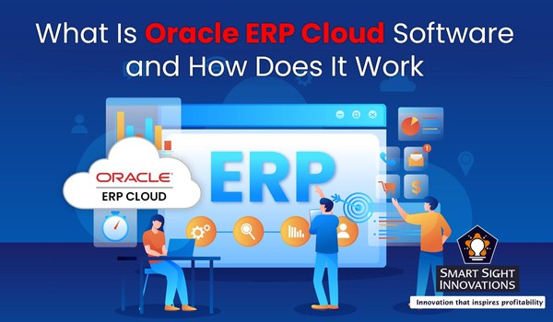
What is
Oracle ERP is a suite of cloud-based business applications that automate and streamline processes across finance, procurement, supply chain, project management, and HR. It provides real-time data, enabling better decision-making and operational efficiency for organizations of all sizes.
Finance: Manages general ledger, accounts payable/receivable, and financial reporting to support accounting, budgeting, and financial management activities.
Procurement: Streamlines purchasing processes by handling supplier management, sourcing, and contracts to ensure cost-effective procurement of goods and services.
Supply Chain Management: Optimizes inventory, production planning, logistics, and order fulfillment to improve efficiency and reduce costs across the supply chain.
Project Management: Helps manage project planning, execution, and financials, ensuring projects are completed on time and within budget. Human Capital Management (HCM): Manages HR processes like recruitment, payroll, employee development, and performance management.

Slide 3
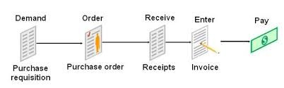
The Purchasing Cycle
Requisition: User creates a request for goods or services.
Purchase Order: PO is created and approved, detailing items, quantities, and supplier.
Goods Receipt: Goods are received and verified against the PO. Invoice Matching: Invoice is matched with PO and receiving document. Payment Processing: Payment is approved and processed.
R e q u i s i t i o n : U s e r c r e a t e s a r e q u e s t f o r g o o d s o r s e r v i c e s

Slide 4

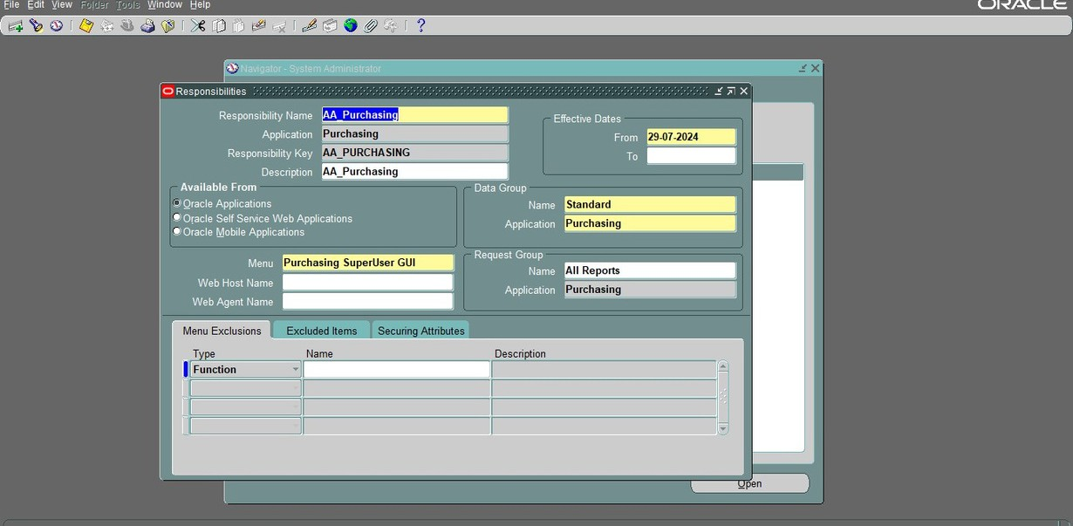
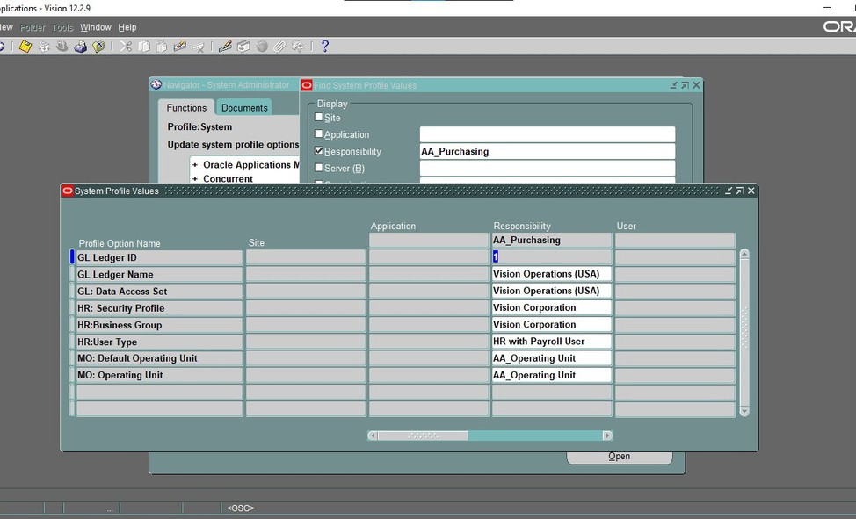
1.creating purchasing responsibility
2. System Profile Values
-Function-Specific Access: A "Purchasing Responsibility" provides access to
purchasing-specific functions, menus, and reports. Without it, a user would not see the options needed to create or manage purchase orders. -responsibilities control which parts of the ERP the user can access, protecting sensitive data
and ensuring users can only view and modify information relevant to their role.
-Function-Specific Access: A "Purchasing Responsibility" provides access to purchasing- specific functions, menus, and reports. Without it, a user would not see the options needed to create or manage purchase orders.
-responsibilities control which parts of the ERP the user can access, protecting sensitive data and ensuring users can only view and modify information relevant to their role.

Slide 5
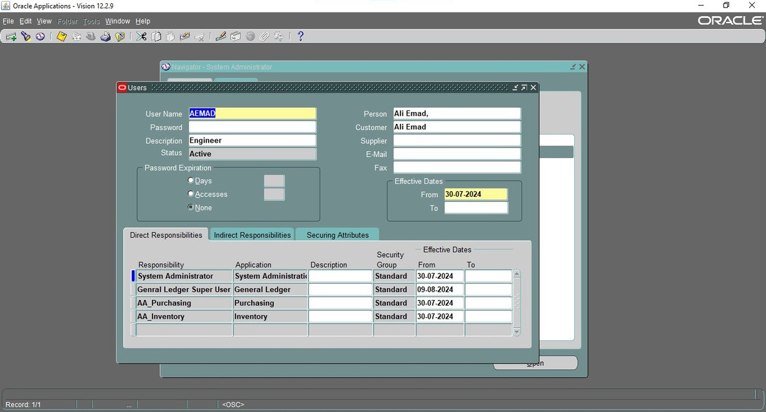
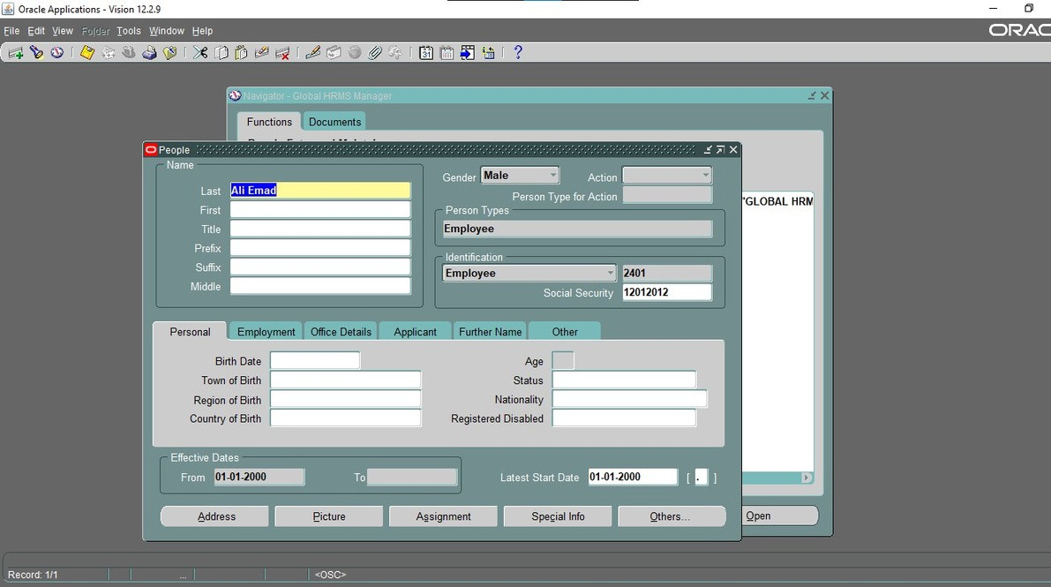
4. Defining and employee in the Global HRMS
3. Adding Responsibility to the User
-Adding a responsibility to a user in Oracle ERP is crucial for controlling access and ensuring that the right individuals have appropriate permissions to carry out specific tasks, like creating purchase orders.
Defining an employee in Oracle's Global HRMS Manager is essential in the purchasing process for the following reasons:
User Identification: It connects user accounts with their organizational role, allowing the system to identify users beyond their login credentials.
Approval Hierarchy: It enables the setup of approval workflows, including limits and notification routes, which are key for managing purchase order approvals.
Cross-Module Integration: Employee data is shared across modules, ensuring consistency and reducing redundancy in systems like financials, projects, and procurement.
This step supports role-based access, security, and streamlined data management across Oracle ERP.

Slide 6
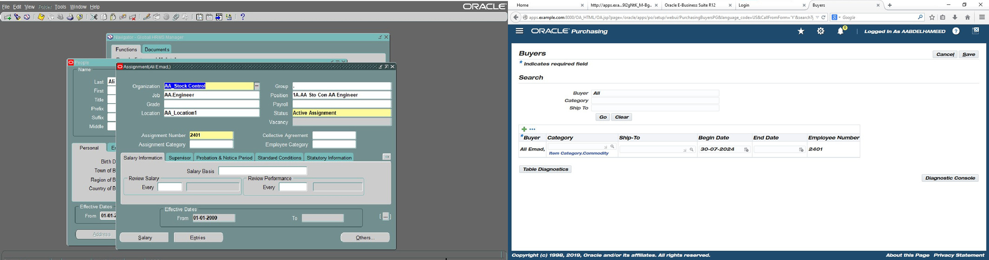
6. Defining a Buyer
5. Assigning Job Role to employee
Assigning a job role links employees with their specific functions and permissions, enabling efficient, secure access and compliance across Oracle ERP.
Defining a Buyer in Oracle ERP is essential for managing procurement responsibilities. It grants the assigned employee authority to create and manage purchase orders, facilitates supplier interactions, ensures accountability by tracking procurement activities, and integrates the
buyer into approval workflows. This role ensures that only authorized personnel handle purchasing, improving efficiency, security, and compliance within the ERP system.

Slide 7
6. Defining a Buyer
5. Assigning Job Role to employee
Assigning a job role links employees with their specific functions and permissions, enabling efficient, secure access and compliance across Oracle ERP.
Defining a Buyer in Oracle ERP is essential for managing procurement responsibilities. It grants the assigned employee authority to create and manage purchase orders, facilitates supplier interactions, ensures accountability by tracking procurement activities, and integrates the
buyer into approval workflows. This role ensures that only authorized personnel handle purchasing, improving efficiency, security, and compliance within the ERP system.

Slide 8
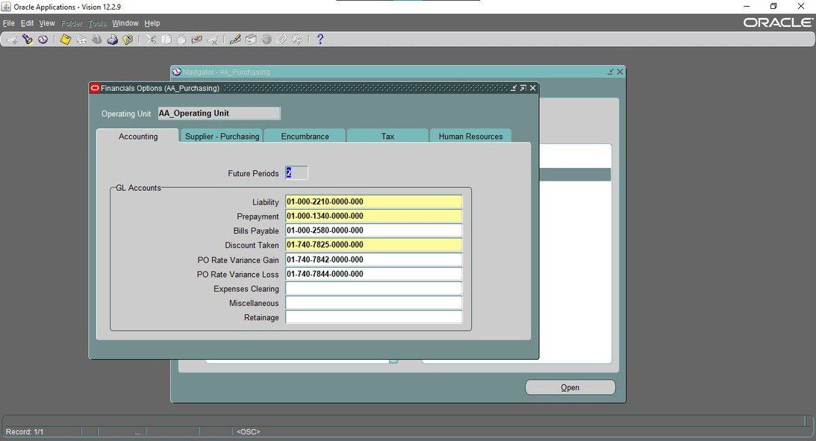
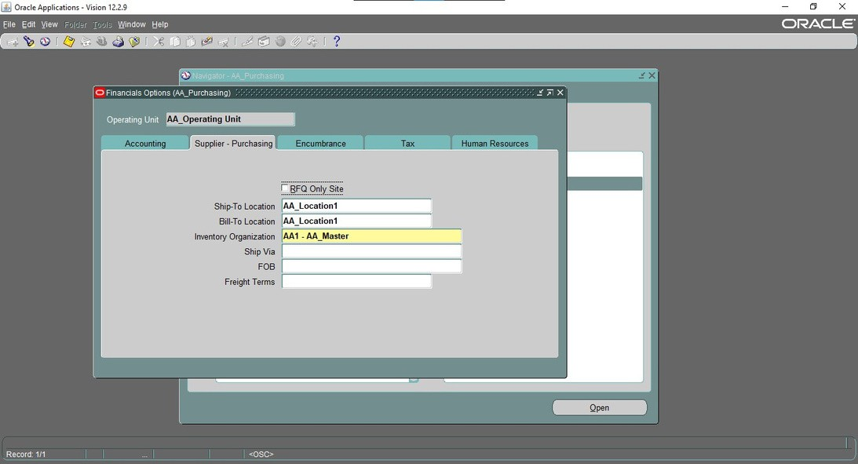
7. Financial Options SetUp
In this step, you’re setting up Financial Options within the Oracle ERP Purchasing module. This configuration is essential because it defines how financial transactions associated with purchasing activities are managed within the system
8. Financial Options SetUp
By defining these Supplier - Purchasing options, you set up a foundation that standardizes key logistical and financial data for purchasing transactions

Slide 9
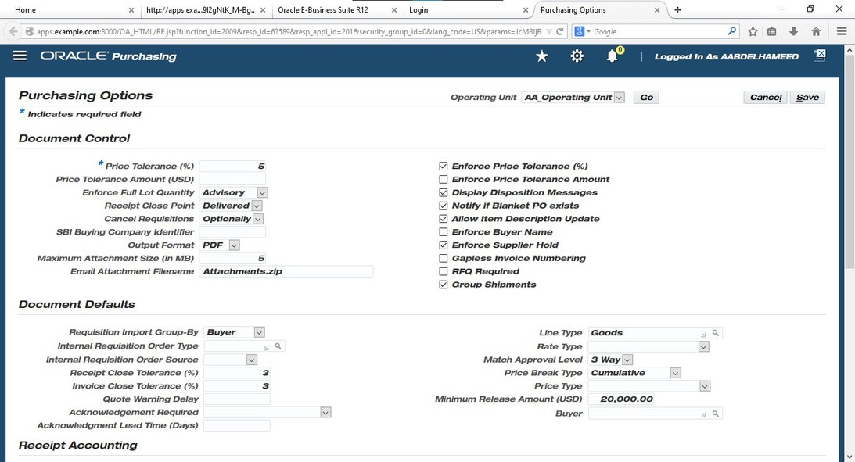
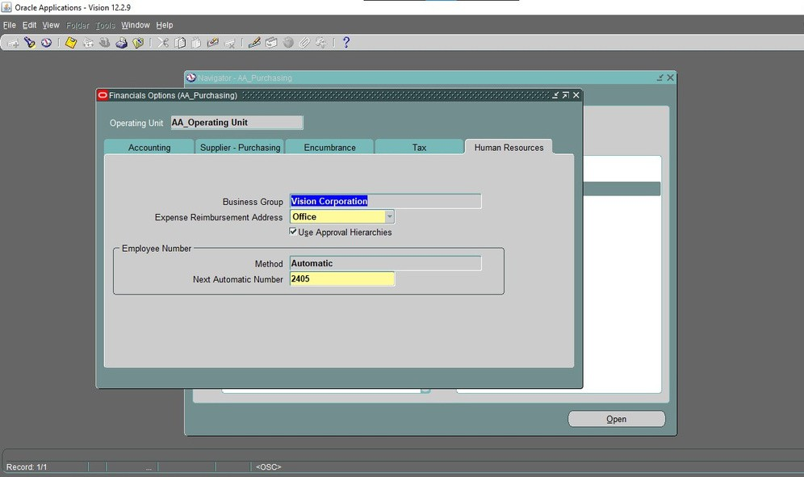
9. Financial Options SetUp
In this step, you’re setting up Financial Options within the Oracle ERP Purchasing module. This configuration is essential because it defines how financial transactions associated with purchasing activities are managed within the system
10. Purchasing options setup
This is specifically showing the Purchasing Options setup window. This window is used to configure purchasing options and default values that control how the purchasing processes operate within an organization:
Document Control
Document Defaults

Slide 10
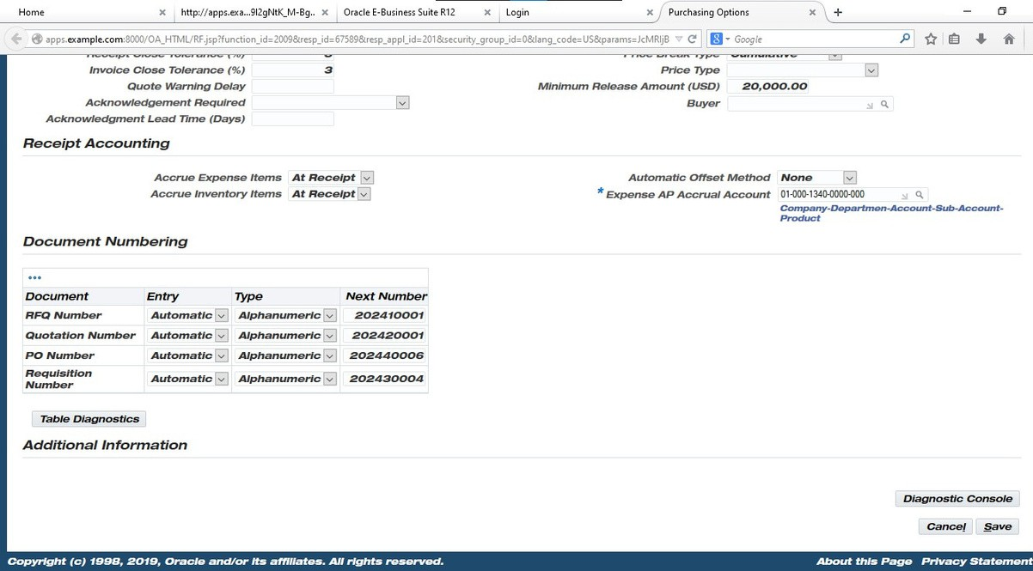
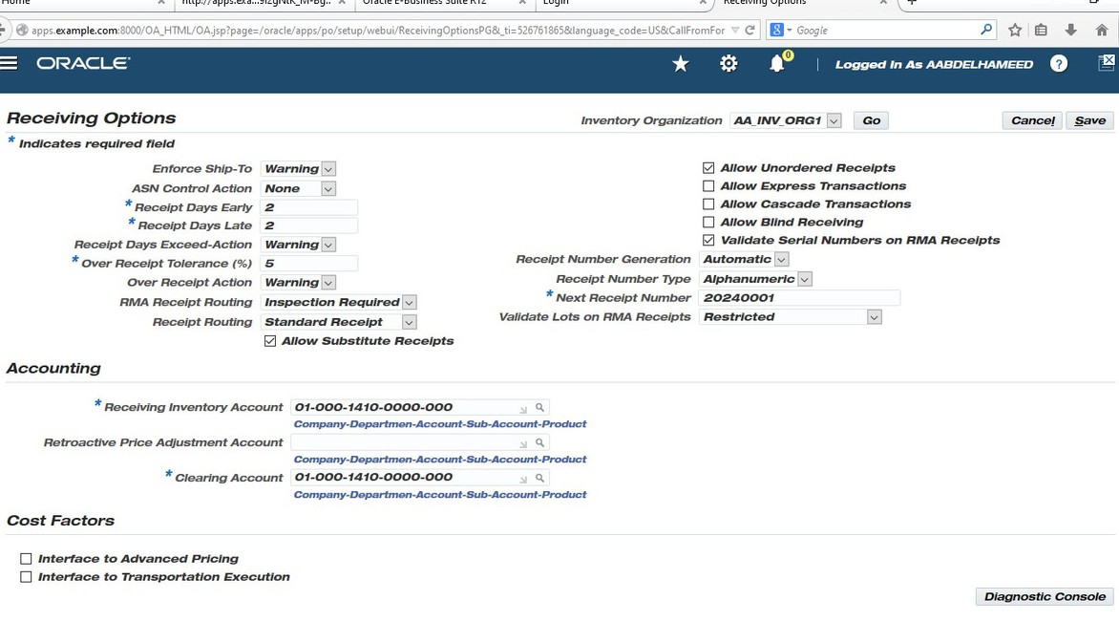
11. Purchasing options setup
12. Purchasing options setup
Receiving Options are configurations that determine how the system manages the receipt of goods and services. These settings define rules and defaults for the receiving process, helping to streamline and standardize how receipts are handled across the organization.
the Purchasing Options setup window. This window is used to configure purchasing options and default values that control how the purchasing processes operate within an organization:
Receipt Accounting settings
Document Numbering : refers to the system of assigning unique identifiers to various purchasing documents like purchase orders (POs), requisitions, receipts, and invoices. This numbering is essential for tracking, managing, and organizing purchasing activities. Document numbering ensures that each document can be referenced accurately throughout the procurement and payment process.

Slide 11
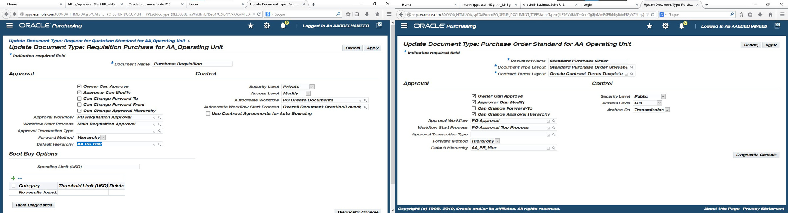
13. The Purchase requistion options
14. Purchasing orders
This window configures settings for Purchase Requisition documents in Oracle Purchasing. It defines approval options (e.g., who can approve, modify, and forward requests), security levels, workflows, and spending limits for requisitions. This setup ensures requisitions follow the organization’s approval hierarchy and workflows, maintaining control and compliance.
A Purchase Order (PO) in Oracle Purchasing is an official document authorizing the purchase of goods or services from a supplier. It includes key settings for approvals, workflows, and access controls. These configurations ensure POs follow the organization’s approval hierarchy, spending limits, and sourcing rules, providing structured and compliant procurement processes.

Slide 12
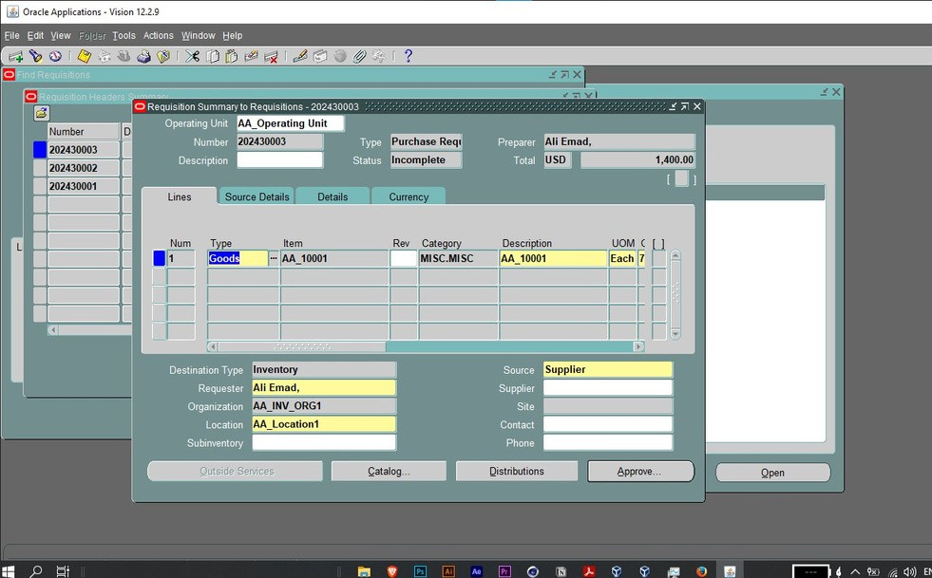
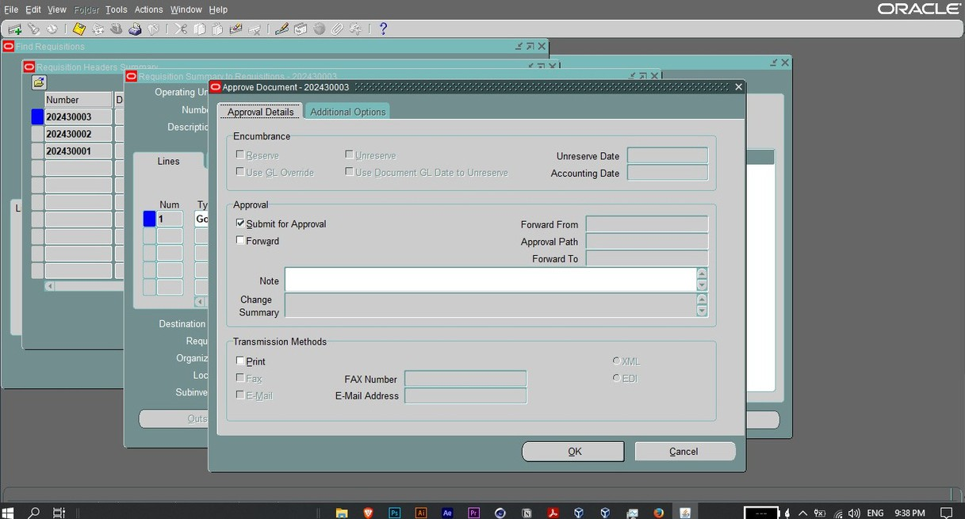
15. Creating PR and approval
In Oracle ERP, creating a Purchase Requisition involves formally requesting goods or services within the organization. It includes details like item description, quantity, delivery date, and cost. The requisition goes through an approval process before being converted into a Purchase Order for the supplier. This process helps streamline procurement and ensure budget control.
"This shows a crucial step in the purchase order (PO) creation process: updating supplier information. Here, we're ensuring we have the most accurate and up-to-date details for our vendor details like Supplier ID, Registry ID, and supplier sites. This information is crucial for efficient procurement and vendor management.

Slide 13
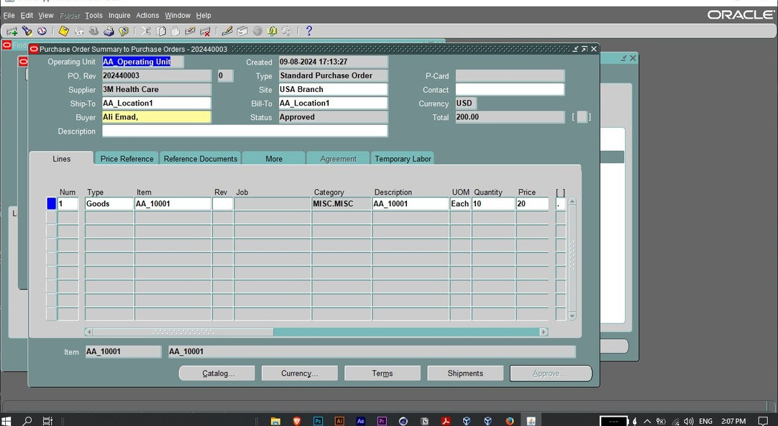
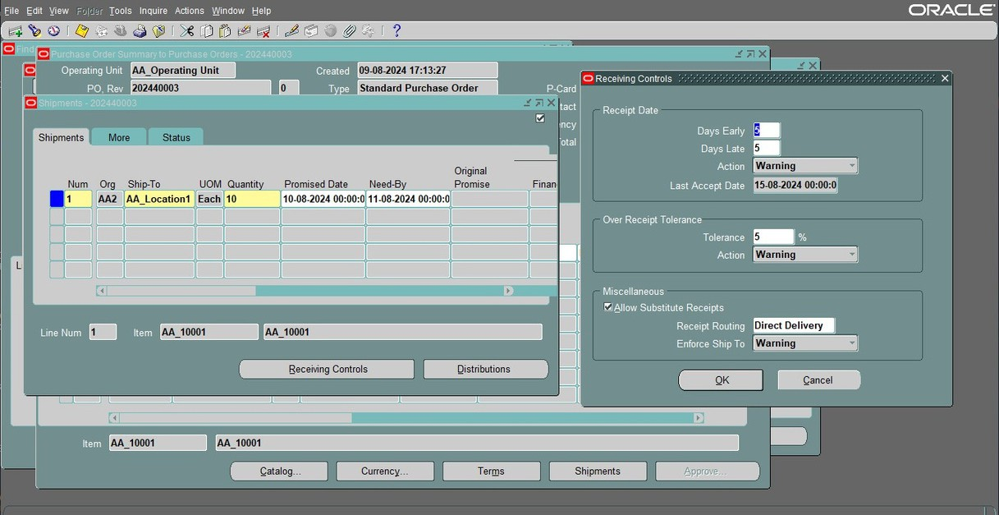
16. Creating a purchase order
17. Adding Shipment Details
The screen displays information about a specific purchase order, including the order number, supplier, items being purchased, quantities, prices, and total cost. It also shows the status of the order, which in this case is "Approved."
The screen displays information about the order, including the order number, supplier, items being shipped, quantities, and due dates. It also shows the status of the shipment process

Slide 14
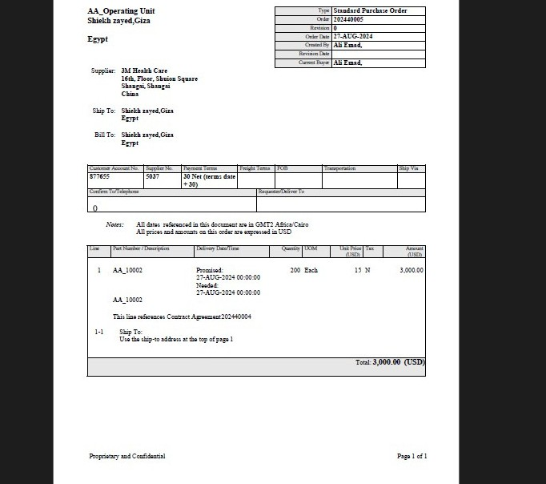
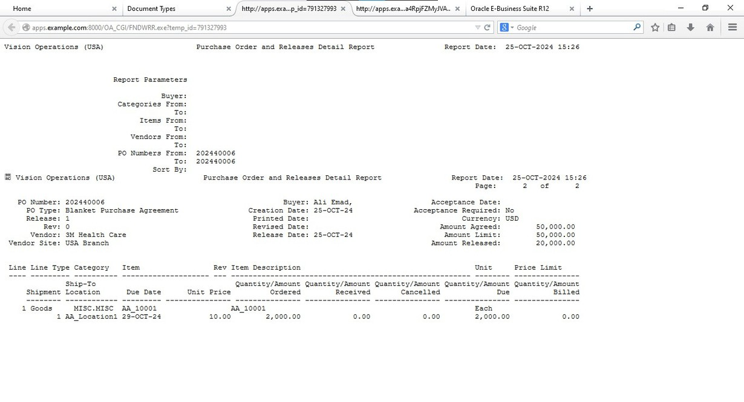
18. Sample of completed PO
19. Purchase order and release report
This is a purchase order document. The document displays information about the order, including the order number, supplier, items being purchased, quantities, prices, and total cost.
The report displays information about a specific purchase order, including the order number, supplier, items being purchased, quantities, prices, and total cost. It also shows the status of the order and any releases that have been made against the order.

